Slide 1

National Popular Vote Interstate Compact
Guaranteeing the Presidency to the candidate who receives the most popular votes in all 50 states
1
Notes:
Nationalpopularvote.com

Slide 2
Did you know?
There have been 5 times when the presidential candidate who received the most votes nationwide LOST the election!
1824 – Andrew Jackson lost to John Quincy Adams
1876 – Samuel Tilden lost to Rutherford B. Hayes
1888 – Grover Cleveland lost to Benjamin Harrison
2000 – Al Gore lost to George W. Bush
2016 – Hillary Clinton lost to Donald Trump
2
Notes:
*Each of those listed had the most votes across the nation, but lost the election either in the Electoral College or in the House of Representatives
(House elected John Quincy Adams instead of Andrew Jackson who had more popular votes.)
*It is theoretically possible to win the presidency (electoral college) with just 23 percent of the popular vote.
*** How does this happen?

Slide 3
The U.S. Constitution established the Electoral College to elect the President of the United States
The U.S. Constitution says in Article 2, Section 1:
“Each state shall appoint, in such manner as the Legislature thereof may direct, a number of electors, equal to the whole number of Senators and Representatives to which the State may be entitled in the Congress.”
The Constitution does not say HOW this appointment of electors is supposed to be accomplished in each state.
3
Notes:
*So how does the electoral college work?
Let’s review what we learned in junior high school.

Slide 4
Presidents are elected by the number of electoral votes they receive
According to state law, when you vote for President, you are really casting a ballot for a slate of electors for your state. The state legislature has the exclusive power to choose how electors are picked.
Each state political party chooses a slate of electors. Selection of electors and their responsibilities are determined by state law (not federal). The method of choosing the members of the electoral college is NOT in the U.S. Constitution.
Electors vote for their party’s candidate in the Electoral College.
In Missouri, and most states, names of electors do not appear on the ballot; only the presidential candidates are shown.
4
Notes:
“So how do Presidents receive electoral votes?”
*The state legislatures get to choose HOW the electors are awarded. In MO, the state political parties choose a slate of electors for their party. Then the state legislature says that the slate of electors from the party that receives the most popular votes in the state gets to have their whole slate of electors certified.
*Electors are “officially” pledged because there is no real consequence if do not follow the legislators’ direction. There have been federal court rulings about unfaithful electors both ways – one that ruled the elector must follow the direction of the legislators and one that ruled the elector must not follow the direction of the state legislature.
From the NYTimes:
The Aug. 20, 2019 ruling from a three-judge panel of the United States Court of Appeals for the 10th Circuit, in Denver, backed up an electors constitutional claim that he could cast his vote however he chose. This decision was the reverse of a ruling by the Washington State Supreme Court in May that upheld that state’s law imposing a fine of $1,000 on three faithless electors. That court noted that the Constitution gives states near-total authority over electors.

Slide 5
Presidents are elected by the number of electoral votes they receive
The candidate who wins the popular vote in a state gets to have their entire slate of electors certified - “Winner-take-all.” (Maine and Nebraska work differently.)
Nationwide, there are 538 electors. A state gets 1 elector for each House member + 2 (for their Senators). In addition, the District of Columbia gets 3. U.S. territories such as Puerto Rico, Guam, etc. get none. 435 in House + 100 in Senate + 3 for DC = 538 electoral votes total
A candidate must receive 270 or more electoral votes to win.
According to the Constitution, if no candidate gets 270 votes, the House of Representatives meets to decide the winner.
5
Notes:
*The candidate who gets the most popular votes in the state gets ALL the electoral college votes. That means that if a candidate gets only 51% of the popular vote in the state they still will get 100% of the electoral votes. Those 49% of voters for the second-place candidate are not reflected in the electoral votes. “Winner take all” based on the state vote is how it works in all but two two states. Since this state-by-state winner-take-all is the case in nearly all the states in the country, you can understand how a candidate can get more electoral votes than what a nationwide popular vote would yield.
A state could change its law to split the electoral votes proportionally.
*Proportional electoral assignment has its own problems since there would be a good chance that neither candidate would get a majority and the election would get thrown into the U.S. House of Representatives with each state getting a single vote.
*Also the Congressional District method with approximates proportional electoral assignment is distorted by gerrymandering.
Nationwide there are 538 electors which is what you get when you add up all our senators and representatives and 3 for DC. A majority of 538 is 270.

Slide 6
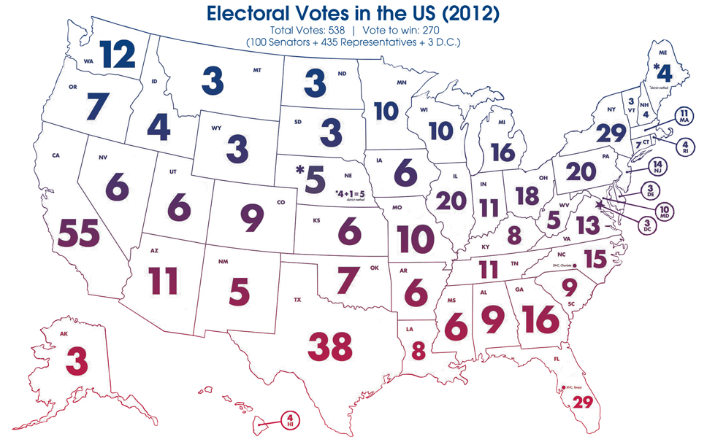
6
Notes:
Here is a map of the states’ elector distribution.
So you see Missouri has 10 electors. We had 11 before the 2010 census and Illinois had 21.
*Number of electors can change again after the census if MO share of US population changes. At “reapportionment” time states can gain or loose representatives. The trend in the US is for the population to move south and west. The population center of the U.S. in 2010 was Plato, MO. 20 years before that it was Steelville, MO.
A state’s number of representatives in Congress, and therefore the number of electoral college votes is another reason that the Census, which is only taken every 10 years, is sooo important. The Census is happening this year. Watch for a card in the mail to tell you how to do it. PLEASE fill out your census information and make sure that your neighbors and friends do too.
Now, let’s take a look at how the electoral college votes are NOT proportional to citizens in the U.S. The electoral college is inherently UNFAIR.

Slide 7
Electors represent a different number of people in each state
Wyoming
3 electors
573,720 population
1 elector : 191,240 people
California
55 electors
39.78 million population
1 elector : 723,300 people
Missouri
10 electors
6.14 million population
1 elector : 614,000 people
Florida
29 electors
21.31 million population
1 elector : 734,800 people
7
Notes:
Currently, an elector represents a different number of people in each state. This is undemocratic. Ideally, in a democratic republic all electoral votes would represent the same number of people. Currently the EC violates the principle of “one person, one vote.”
With the electoral college, states with small populations are given a disproportional amount of influence per voter.
In our presidential elections each vote IS counted. But due to the nature of the current state-by-state, winner-take-all electoral college, voters in some states can not be as effective as voters in other states.
Example of inequality of electoral votes – population determines the number of electors

Slide 8
Major Problems with the current system
The second-place candidate can become President.
A candidate can win without getting the most popular votes in all 50 states.
Voters feel the election does not let their voice be heard.
If you vote for a candidate other than the candidate who received the most votes in your state, your vote is not represented in your state’s electoral votes.
8
Notes:
*5 of our 45 Presidents have come into office without having won the most votes in the country as a whole, thereby undermining a President’s legitimacy and ability to lead. 2 of the last 3 presidents were not elected because they received the most votes.
*And there have been several near miss elections!
Over the last hundred years there have been 6 cases of near miss elections:
In 2004, a shift of less than 60,000 votes in OH would have defeated George W. Bush despite his nationwide lead of 3million votes.
In 1976, a shift of only 9200 votes would have changed the election.
In 1968, a shift of only 78000 votes would have changed the election.
In 1960, a shift of only 9200 votes would have changed the election.
In 1948, a shift of only 20,000 votes would have changed the election.
In 1912, a shift of only 1700 votes would have changed the election.
**The League stands for free, FAIR and accessible elections.
With only the state’s majority candidate getting ALL the electoral votes, the votes for the second-place vote-getter in the state are left out. The current state-by state winner-take-all system that uses state boundary lines to tally votes is NOT fair to voters because every vote is NOT equal throughout the country. If the president does not receive most of national votes, the election is undemocratic. The current system does not achieve “one-person, one-vote,” that is expected in a democracy.
The current state-level tally winner-take-all system allows state’s rights/identity to be more important than the individual voter voices. Most people care more about their personal vote than their state’s identity.
***So, voters can feel that their vote does not matter. It should be that EVERY voter in EVERY state will be politically relevant in EVERY presidential campaign. The current winner-take-all system makes voters less effective in non-competitive states.

Slide 9
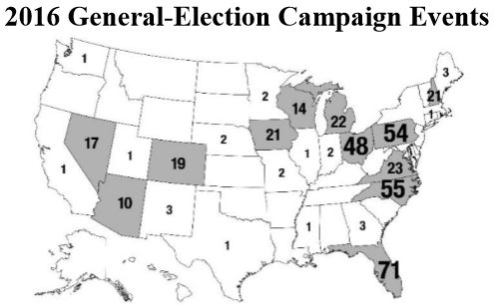
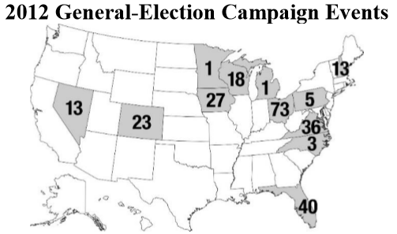
Major Problems with the current system
Most states are IGNORED in campaigning.
Voter issues in non-competitive states are not addressed.
9
Notes:
** Because of “winner take all” in most states, presidential candidates have no reason to solicit votes in states where the statewide outcome is a foregone conclusion- candidates are safely ahead or hopelessly behind. Instead, they just campaign in closely divided swing states.
Check out the maps of who got campaign events in the last two presidential general-elections.
** A campaign visit is not just a matter of whose baby gets kissed in which states. A candidate raises issues and takes positions on the basis of whether they can win some closely divided states which is only about 12 states.
** In 2016, 94% of the general-election campaign events were in only 12 states.
Example from 2012:
*100% general election campaign events were in only 12 states (because races were close, 45%-51%)
*2/3 of events were concentrated in only 4 states
*38 states ignored because one candidate was safely ahead
*In battleground states, candidates campaign in all parts of the state.
**In 2008, 98% of all $ were spent in just 15 battleground states.
**In 2008, 2/3 of money and time was spent in just 6 states.
*Similar strategies were used in 2016.
Some people might say that our current system encourages the parties to build coalitions, but how does this happen when 38 states are excluded from even being considered by the candidates.

Slide 10
Major Problems with the current system
Battleground states get more than their fair share of resources.
  Two times as many disaster declarations for battleground states
  Way more exemptions for superfund sites and No-child Left Behind for closely divided states
  Steel quotas and tariffs for closely divided PA
  TPP axed - battleground states upset about trade
  SBA loans to more companies in close states
  Unfunded Medicare Part D – FL is battleground state with high population of seniors
  Military bases…
10
Notes:
*Pork spending is not just a problem because Congress politicizes spending, it is also a consideration for Presidents.
** After the election, sitting Presidents make numerous policy decisions in favor of the battleground states.
Book by John Hudak of the Brookings Institute, “Presidential Pork(2014)” - he interprets efforts by presidents to control and politicize federal spending and accumulate electoral rewards. Book “The Particulistic President(2015)” by professors Douglas Kriner and Andrew Reeves - examines a diverse range of policies from disaster declarations, to base closings, to the allocation of federal spending, and show that presidents, like members of Congress, are particularistic. Presidents routinely pursue policies that allocate federal resources in a way that disproportionately benefits their more narrow partisan and electoral constituencies.
*Trans-Pacific Partnership went down because battleground states were upset about trade
*Medicare Part D was passed in 2003, the largest federal entitlement program since the 1960’s and was totally unfunded was promoted by a president of the party pushing balanced budgets, fiscal restraint, and small government.” Because FL was a crucial battleground state.
*Steel quotas in 2001 by Pres. George W Bush because of PA steel industry (battleground state)
*Biggest Small Business Administration grant in American history was given to Ricotta cheese factory in Ohio.(2012) by Obama. Was it really to preserve independent cheese industry for the strategic benefit of the U. S.? [Miceli (Cleveland OH) makes ricotta and other cheeses. Miceli was the first to benefit from a new law that raised the limit for SBA loans for manufacturing from $2.5 million to $5.5 million. Miceli was awarded with SBA loans totaling $5.49 million in December 2010. Two months later, Obama cited the loan at an event with small-business leaders in Cleveland.]

Slide 11
Methods to achieve direct election of the President
The LWV believes that direct election of the President is essential for a representative democratic government.
So, we could change the constitution to a direct election for the President including provisions for a national runoff election in the event no candidate received 40% of the vote. This is a LWV position.
- Hard to do and not flexible as the nation changes.
Or, the states could pass laws that would recognize the winner of the election is the candidate who receives the most votes in all 50 states (and D.C).
11
Notes:
The League of Women Voters has had a position for direct election of the president since the 1970’s
Amending the constitution is extremely hard. There is no political will in the U.S. Congress to initiate this amendment.
Remember that I said earlier that the states have the power according to the U.S. Constitution to award the electors any way they see fit.
This is what the National Popular Vote does: The state legislatures use their power to change how they award electors.
Amending the constitution:
1) 2/3 of both houses of Congress and ratified by ¾ of the state legislatures or by state conventions in ¾ of the states
Or
2) 2/3 of state legislatures shall call a convention for proposing amendments and must be ratified by ¾ of the state legislatures or by state conventions in ¾ of the states.

Slide 12
The National Popular Vote
State legislatures enact a law pledging all their state’s electoral votes to the candidate who gets the most popular votes in ALL 50 States and D.C. combined.
A 270-vote trigger. The bill would take effect ONLY when enacted by enough states to reach a majority of electoral votes - 270 of the 538.
This bill guarantees the Presidency to the candidate who receives the most votes in ALL 50 states and D.C.
This bill must be passed by the legislatures of the enacting states because the U.S. Constitution says that the state legislature appoints and directs the Electors.
This bill fully preserves the Electoral College.
12
Notes:
*NPV states make the decision to award electors based on the votes of all the states combined, NOT just their own state tally, NOT just the votes in the NPV participating states.
The 270 electoral vote trigger goes with the interstate compact since all the states with the NPV legislation will act together to be effective.
The legislation of each state must be the same, nearly identical.
“guarantees” – electoral votes are “awarded” The state’s chief election officer will certify the election of the slate of electors who were nominated by the political party of the candidate who received the most popular votes in all 50 states.
“guarantees?” – it is likely that the compact will go into a court battle before those in power will allow this to change.

Slide 13
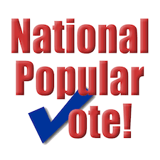
National Popular Vote Status
15 states and D.C have passed NPV = 196 electoral votes
Only 74 more electoral votes needed! Then the compact can go into effect in all the states that passed the NPV legislation.
At LWVUS 2018 convention, a resolution was passed to encourage all state Leagues to advocate for the National Popular Vote.
National Voter Support: Approximately 65%-75% of voters nationwide support electing the President by a direct vote.
13
Notes:
The League accepted the National Popular Vote Interstate Compact as a way to achieve direct election of the president in 2010.
Like ME, most voters in the nation want their vote to count in a combined tally of every voter in every state in the nation.
72% OF THE PUBLIC SUPPORT NATIONWIDE POPULAR ELECTION OF THE PRESIDENT IN 2007 POLL TAKEN BY WASHINGTON POST, KAISER FAMILY FOUNDATION, AND HARVARD UNIVERSITY
Question 22 of the Washington Post-Kaiser Family Foundation-Harvard University Survey of Political Independents conducted in May-June 2007 asked:
For future presidential elections, would you support or oppose changing to a system in which the president is elected by direct popular vote, instead of by the electoral college?
GALLUP POLLS SINCE 1944 SHOW PUBLIC SUPPORT FOR NATIONWIDE POPULAR ELECTION OF THE PRESIDENT
June 22–27, 1944 65% approve
January 14–17, 1977 73% approve
November 7–10, 1980 67% approve

Slide 14
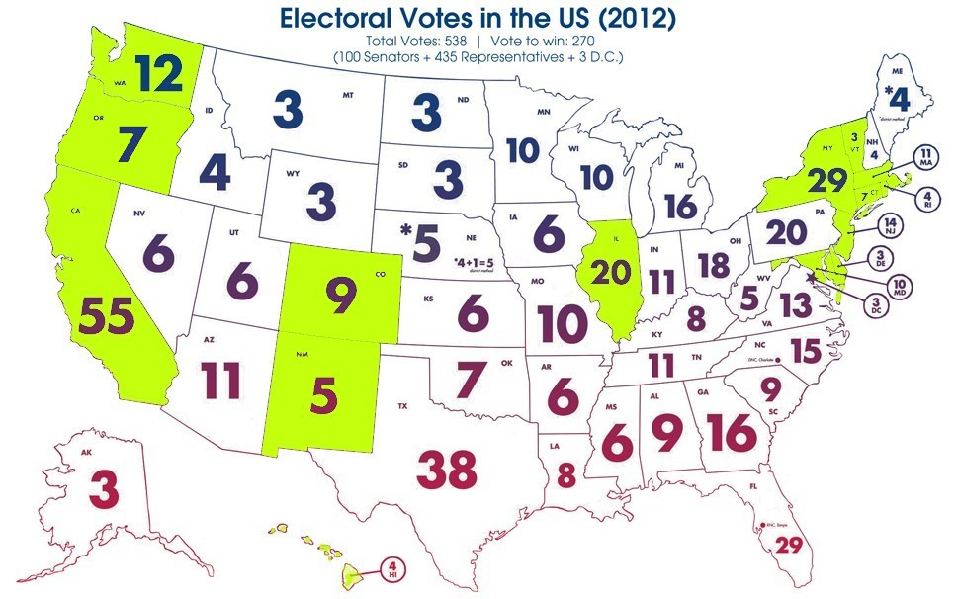
States that passed the NPVIC
California (2011) 55 votes
Connecticut (2018) 7
Colorado (2019) 9
DC (2010) 3
Delaware (2019) 3
Hawaii (2008) 4
Illinois (2008) 20
Maryland (2007) 10
Massachusetts (2010) 11
New Jersey (2007) 14
New Mexico (2019) 5
New York (2014) 29
Rhode Island (2013) 4
Vermont (2011) 3
Washington (2009) 12
Oregon (2019) __7__
TOTAL 196
Additional needed 74
14
Notes:
Here are the states that have passed NPVIC legislation

Slide 15
History of National Popular Vote in MO
MO Voter support: 2015 Missouri Voter Survey showed 75% overall support for the idea that the President should be the candidate who receives the most popular votes in all 50 states.
2018, 2017 - NPV bill introduced by Rep. John Carpenter(D)
2016 - NPV bills introduced by Dave Schatz (R), Tony Dugger(R), Jeremy LaFaver(D), and supported by 58 legislators
2012 – NPV bill introduced by bi-partisan group of 8 representatives
2011 – NPV bill introduced by bi-partisan group of 10 representatives
2009 – NPV bill introduced by group of 7 representatives
2007 – NPV bill introduced by group of 6 representatives
2006 – NPV bill introduced by 2 representatives
15
Notes:
*NPV unanimously approved in a MO House committee in 2016
*840 MO Voters were asked, “ How do you think we should elect the President: Should it be the candidate who gets the most votes in all 50 states, or the current electoral college system?”
*By political affiliation: republicans 78%, democrats 73%, independents/other 73%
*By gender: women 79%, men 70%
*By age: 18-29 yr olds 82%, 30-45 yr olds 66%, 46-65 yr olds 76%, 65 and older 73%

Slide 16
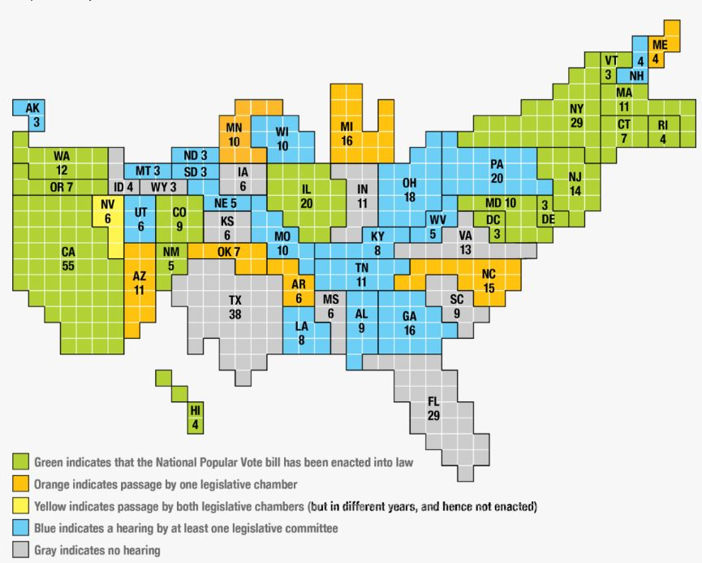
National Status of NPV
16
Notes:
https://www.nationalpopularvote.com/sites/default/files/eve-4th-ed-ch-9-myths-2013-2-21.pdf
https://equalvotes.us/faqs/

Slide 17
National Popular Vote Summary
The candidate with most popular votes in the entire country becomes president!
Every voter in every state will be relevant in every presidential campaign.
Every vote will be equally meaningful in every election.
Voting power for all citizens is fair.
Campaigns would no longer ignore 2/3 of the states. You would not have to be a swing state to get attention.
NPV encourages citizen participation.
NPV encourages a culture of higher voter turnout when every voter feels important
17
Notes:
I am in the speakers bureau for our League. On occasion I have spoken to groups of young people to encourage them to vote. At more than one of these events I have heard comments from these young voters questioning why their vote matters when it all that really matters is the electoral college… that the election process is not made for an individual’s voice to be heard. It does not seem FAIR. NPV helps every voter feel that their vote matters.
With NPV, no individual’s vote will be cancelled out at the lower [state] level.”
“the idea that one group can be granted greater voting strength than another is hostile to the one man, one vote basis of our representative government.”

Slide 18
NPV Concerns & Responses
The LWV considered the arguments against NPV and, has weighed those arguments to be insignificant compared to our democracy’s need to move forward to “one person – one vote”.
The League reached consensus to support the National Popular Vote Interstate Compact in 2010.
A comprehensive list of concerns and responses can be found at https://www.nationalpopularvote.com/answering-myths,
and in the book, “Every Vote Equal” by John Koza.
18
Notes:
Listed next are some of these concerns and then how the concerns are inaccurate.

Slide 19
Small States Concern – NPV will lessen the need of presidential candidates to campaign for voters in rural areas and small states.
Response - Facts do not support this.
* With the current system many small states now get almost no presidential campaign visits (states are both D and R) because they are safely D or R.
-12 small ignored states population = population of OH;
-12 small states total 40 electoral votes and OH has 18 electoral votes. But still OH got 73 campaign visits. 12 small, ignored states got 0 campaign visits.
-NH (only small state to get visits) did get 12 visits because is a closely divided battleground state.
-Only 3 of smallest 25 states matter and got any events: NV, IA, NH because they are closed divided.
* 6 of the states that have passed NPVIC are small states.
19
Notes:
Our CURRENT system does not prevent small states from being ignored. It just encourages candidate to spend nearly all their time in battleground states. The current system magnifies the influence of voters in the majority of every state.
“12 ignored states” data is from 2012 election.
Of the 12 smallest states 6 are democratic (DE, DC, VT, RI, HI, ME) and 6 are republican (AK, MT, ND, SD, WY, ID)
Small states is defined as 5 or fewer electoral votes.

Slide 20
Big Cities Concern - NPV would shift political battles to the big cities.
Response - Evidence does not support this.
*Big cities are assumed to be bigger than they are.
  10 biggest cities = 8% U.S. pop
  50 biggest cities = 15% U.S. pop
  - 100 biggest cities = 1/6 (17%) U.S. pop and vote 63% democrat
  - Rural = 1/6 U.S. pop and vote 60% republican
  - Suburbs = 2/3 U.S. pop and vote evenly divided
* If this concern were true you should see evidence of this today.
    Real data from OH, a battleground state shows:
- 4 biggest OH metro areas – 54% pop got 52% of campaign events
- 7 mid-size metro areas – 23.6% pop got 23.3% of campaign events
- rural areas – 22% pop got 25% of events
20
Notes:
*A presidential candidate who focused only on America’s cities and urban centers would lose — there just aren’t enough votes. Republicans live in cities just like Democrats live in rural areas. Under a popular vote, candidates would have to build national coalitions across demographic and geographic lines. The difference is that those coalitions would involve every region of the country instead of a handful of competitive states in the Rust Belt and parts of the South.

Slide 21
Big States and Big Counties Concern – NPV would allow big states and big counties to have all the power.
Response – This is a false argument because it assumes that 100% of the voters in these highly populated areas will all vote the same way.
*Political reality is that no candidate received more than 63% of the popular vote in any of the 12 biggest states presidential elections between 1988 and 2016.
*Half of U.S. population lives in the 12 biggest states and half of population lives in just 60 counties, but they do not control the outcome of elections. Compare 2004 (Bush/Kerry) election and 2012(Romney/Obama) election.
- Bush won 38 smallest states popular vote and won the election.
-Obama won 12 biggest states popular vote and won the election.
21
Notes:
This argument has a fallacy that it talks about places as if they were people. It is behind the false notion that w/o the EC, NY and CA would decide every election. NY and CA are two of the most economically and racially diverse states with millions of red voters.
This fallacy also pits rural voters and urban voters against each other. People living in a particular area will have problems in common but that does not mean that all voters in an area agree on how to solve those problems.
As shown by Bush/Kerry and Obama/Romney elections, a candidate can win with either the 12 biggest states or the 38 smallest states popular vote.

Slide 22
Fraud Concern – Voter fraud is minimized with current system because it is hard to predict where stolen votes will matter.
Response – The opposite is true. Voter fraud would be made less consequential with NPV.
*Fraudulent votes matter the most in battleground states where a small number of people can have a very large impact in determining all the electoral votes for a whole state.
-537 popular votes in FL flipped enough electoral votes in 2000 to determine the president (537 votes would have been insignificant in the 105 million votes cast nationally.)
*It is harder to mobilize massive voter fraud on a national level than in a few key states.
*Fraud by a single large pool of votes is less likely to affect the outcome of a presidential election with the NPV system than the current method of state-by-state winner-take-all electoral college.
22
Notes:
The problematic presidential elections in the past six decades are reminders that the operation of the state-by-state tally winner-take-all system today all in 51 separate jurisdictions makes razor thin margins more likely. And therefore makes electoral mischief and fraud more rewarding. “Under a direct popular vote system, one fraudulent vote wins one vote in return. In the electoral college system [based on just the state’s tally], one fraudulent vote could mean many electoral votes.”

Slide 23
Recounts Concern – NPV would result in constant recounts.
Response – In fact, NPV would make recounts much less likely.
*Historically, disputes have been much more common under current presidential electoral system when compared to state general elections.
- only 22 recounts in 4072 state general elections (1 in 185 elections) (yrs 2000- 2012)
- 5 recounts in 57 presidential elections
*Recounts become less likely as the pool of votes becomes larger.
*Current system produces artificial crisis that would not have arisen if it had been a larger pool of voters.
23
Notes:
*Current system and NPV would handle recounts the same. As a matter of regular planning, state election officials have contingency plans to conduct a recount for every election.
*Recount laws are different in every election. Only 19 states have automatic recount laws. 42 states have laws that allow the candidate to petition for a recount. In most states there are numerous avenues available for making a recount happen.
*The tight time restraint caused by the “safe harbor” date, (6 days before the EC meets in December), is there regardless of the current system or NPV.
*A major obstacles to obtain a timely recount is there can not be a recount until there is an “official” count. Official state-wide count typically takes several weeks as official documents certifying the count from each county must be sent to the state’s chief election official. The facts are that, under the CURRENT system, the possibility of conducting a timely recount of a presidential recount is largely an illusion.
*Regardless of the election system, there does need to be improvement in state recount laws as the early winner is currently motivated to just keep the election result in court until the dates passes to certify the election. But this legislation would best happen at the federal level to guarantee timely recount in a presidential election.

Slide 24
Totally Partisan Issue Concern - NPV benefits Democrats more than Republicans.
Response - NPVIC has received bi-partisan support in states where this legislation has been adopted.
*It will benefit all voters because candidates will no longer focus their time and money only on the 6 to 12 “battleground states”.
*With NPV, Republican voters in Democratic states will not be erased, but counted equally in a national tally. Similarly, Democratic voters in Republican states will be counted equally. “One Person-One Vote” will determine our President.
*In Missouri in the past, both Democrats and Republicans have sponsored NPV legislation.
24
Notes:
Under the current state “winner-take-all” system, the red voters in blue states, as well as, the blue voters in red states are disenfranchised because all the individual voter’s voices are not put into a big national sum.
Just remember that CA and NY had Republican governors not so long ago. And MO had a Democratic governor. Kansas has a Democratic governor now. There are many voters, Democratic and Republican, all over the nation who should be equally counted in the vote for President with NPV.
2016, Feb. - NPV bill introduced by Senators Dave Schatz (R) and Rob Schaaf (R) [Schatz is now the leader of the MO Senate] Dozens of state senators and reps both D and R sponsored NPV bills or voted Yes in committee
2016, Jan. – NPV bills introduced by Reps Tony Dugger (R) and Jeremy LaFaver (R)
2012 – NPV bill introduced by bi-partisan group of 8 representatives
2011 – NPV bill introduced by bi-partisan group of 10 representatives

Slide 25
Constitutionality Concern – NPV violates the U.S. Constitution.
Response – NPV is a constitutionally conservative, state-based approach that does not alter or violate the U.S. Constitution and retains the electoral college and state control of elections.
*For NPV, states still appoint electors per the U.S. Constitution. Our Constitution does not require ”winner-take-all” rule.
*Historically, each state’s dominant party instituted “winner-take-all” to maximize the party’s power.
*Supreme Court has not ruled to restrict states from using whatever method they want to appoint their electors, “The appointment and mode of appointed of electors belong exclusively to the states.” (Article II, Section One) Neither Maine nor Nebraska use the “winner-take-all” method and it has been challenged in court.
25
Notes:
*Sen. MO Senator Thomas Hart Benton warned that the “winner-take-all” was not intended to give fair play to the will of the people. It was adopted to enable the leading men of the state to consolidate the vote of the State. (1824)
*In 1823, Madison referred to the winner-take-all system that had already spread to 10 states as “evil”
Other compact examples/ court cases:
Cuyler vs. Adams, 449 U.S. 433 (1981) and U.S. Steel Corporation vs. Multistate Tax Commission, 434 U.S. 452 (1978). The Court reinforced the role of interstate compacts in the relationships between states, as a tool to be used by the states and approved by Congress.
Article I, Section 10, Clause 3 of the U.S. Constitution laid the legal foundation for interstate compacts: “No State shall, without the Consent of Congress, lay any Duty of Tonnage, keep Troops, or Ships of War in time of Peace, enter into any Agreement or Compact with another State, or with a foreign Power, or engage in War, unless actually invaded, or in such imminent Danger as will not admit of delay.”
Article I,Section 10 re: Interstate Compacts.
Virginia v. Tennessee,148 U.S.503(1893) Summary- not all
compacts between states require explicit Congressional approval.
Only those agreements which would increase the power of the states at the expense of the federal government require it.
Article II, Section 1 re: " Each State shall appoint, in such Manner as
the Legislature there of may direct, a Number of Electors, equal to...."
McPherson v. Blacker,146 U.S. 1(1892) Summary-" the state
legislature's power to select the manner for appointing electors is
"plenary" (whole,absolute)
Williams v. Virginia State Board of Elections,288 F. Support.622(1968). Summary- the unit rule is upheld vs. districts
each choosing electors. (( Against our position in this same ruling is the
mention of Delaware v New York(and all other states) to make the
unit rule of electors vote unconstitutional. The Supreme CT declined
to hear the case.))
At their most basic level, interstate compacts are contracts between two or more states. As such, compacts are governed by the tenets of contract law, meaning an offer to enter the agreement is expressed by the first state to join the compact and accepted by each subsequent jurisdiction that also joins. A state voluntarily elects to join a compact in the same way that any piece of legislation is passed and adopted.
States have used interstate compacts to address a variety of challenges, including:
Resolving boundary disputes;
Managing shared natural resources; and
Creating interstate administrative agencies in a wide range of policy areas, including tax reform, education, criminal justice, licensing, and energy and environment.
This diversity is one of the primary benefits interstate compacts provide. They can be used to address a variety of challenges, from the very simple to the extremely complex. Compacts also provide other advantages, such as allowing states to maintain their sovereignty by providing a means to act collectively outside the confines of federal legislation or regulation. Compacts let states develop a dynamic, self-regulatory system that remains flexible enough to address changing needs.

Slide 26
Republic Concern – NPV violates the “republic” ideal of the U.S. Constitution.
Response – The U.S. will remain a republic with the NPV approach to awarding electors.
*Popular election of the chief executive does not determine whether a government is a republic or a democracy.
*We elect every other office across the nation with a popular vote – mayors, governors, representatives, and senators.
*With NPV, states maintain primary responsibility for the ballot and for qualifications of voters and does NOT centralize federal power.
*The EC was not designed for minority rule. Virtually everything in the Constitution was geared toward producing representative majorities that could govern on behalf of the country.
26
Notes:
**Rebuttal to “We live in a republic.”
In a republic the citizens do not rule directly, but instead elect people to represent them and to conduct the business of government.
Definitions:
Republic = a government in which the extreme power resides in a body of citizens entitled to vote and is exercised by elected officers and representatives responsible to them and governing according to the law
Democracy = is a government in which the supreme power is vested in the people and is exercised by them directly or indirectly through a system of representation usually involving periodically held free elections”
Direct democracy = a form of government in which citizens vote not just for “representatives”, but vote directly on policies and governing matters (e.g., budgets, revenue, expenditures, etc.). While many states have ballot initiatives and referenda which empower citizens to vote on substantive issues, this is not the Constitutional role of citizens in the operations of the federal government.
…The Founding Fathers built a government to stymie the “tyranny of the majority.” They contrasted their “republic” with “democracy,” which they condemned as dangerous and unstable. But for the founders, “democracy” did not mean majority rule in a system of representation. The men who led the revolution and devised the Constitution were immersed in classical literature and political theory of Ancient Greece. In more modern terms, the founders feared “direct democracy” and accounted for its dangers with a system of “representative democracy.” Yes, this “republic” had counter-majoritarian aspects, like equal representation of states in the Senate, the presidential veto and the Supreme Court. But it was not designed for minority rule. Virtually everything was geared toward producing representative majorities that could govern on behalf of the country — to diminish “faction” in favor of consensus. And in the case of the Electoral College, the point wasn’t to stymie majorities but to provide a way to find a competent and popular chief executive in a large nation of diverse states. There’s really no difference, in the present, between a “republic” and a “democracy”: Both connote systems of representation in which sovereignty and authority derive from the public at large.
The U.S. Constitution Guarantee Clause – “The U.S. shall guarantee to every State in this Union a Republican Form of Government.”
At the time of the Constitutional convention in 1787, CT, MA, NH, RI all conducted popular election for Governor and was not in violation of this clause.
NPV preserves the power of the states to conduct elections – an important element in federalism. And NPV preserves the power of states to make future changes in the method of electing the president.

Slide 27
Questions???
Notes:
Every vote across the country should carry equal weight regardless of where it comes from.
Near the time of her death, Alice Paul said, ‘I think if we get freedom for women, then they are probably going to do a lot of things that I wish they wouldn’t do. But it seems to me that isn’t our business to say what they should do with it. It is our business to see that they get it.’
This freedom for all voter’s voices to be equally represented might be something that some groups say will allow the “uninformed” to make wild choices. But this is exactly what Alice Paul was referring to about women getting equal votes a hundred years ago. And it is the same now - we should count all votes across the nation equally today.
“the idea that one group can be granted greater voting strength than another is hostile to the one man, one vote basis of our representative government.”
“the idea that one group can be granted greater voting strength than another is hostile to the one man, one vote basis of our representative government.”

Slide 28
National Popular Vote Interstate Compact
NOW ACT… If you support every vote counting equally in all 50 states when we elect the President, make calls and write letters to make your voice heard. Let friends, neighbors, and elected officials know that you think individual voter power is more important than a state’s political power.
Guaranteeing the Presidency to the candidate who receives the most popular votes in all 50 states
28
Notes:
The League of Women Voters is a non-profit, non-partisan organization. If you find the information that I brought to you tonight to be valuable to you, please consider giving a donation to the League.
Thank you for inviting me here to speak with you today.

Slide 29
15% Pres. Elections/Regional and Extremist Candidates/2-party system Concerns - The winner is the person with the “largest total” number of votes, a majority is not required and a minimum plurality is not required, so the president could become someone with only a small number of supporters.
Response – History shows no evidence to support these concerns
*There is no past evidence out of thousands of plurality elections across the country (state or regional) that winners get only 15% of the votes. The concern is simply hypothetical.
*With the current system in states (direct election of governors and senators), no regional parties have formed in areas across the nation. Similarly, no extremist candidates have won statewide contests with direct popular vote.
*No history of a breakdown of the 2-party system. A 2-party system is sustained when plurality voting is used to fill an office - Duverger’s Law, based on worldwide study of elections.
Notes:
*Many presidents did not win the majority of votes. Lincoln had only 39%.

Slide 30
Missing Votes and Hurricanes Concerns – Bad weather might delay vote counts until after the electoral college meets. Provisional ballots take much time to be counted.
Response – Current system is more susceptible.
*Additional personnel can be used to get the count done before the electoral college meets in mid-December.
*Current state by state electoral college vote is more susceptible to the delay because a smaller number of votes can affect the determination of all the electors for a state.
*NPV minimizes the effect of the weather because the outcome of a presidential election is less likely to be changed because the number of regional votes are a smaller portion of a big national total. Regional votes are a larger proportion of a state’s total voting which is used in the current method, and thus, make a weather a larger worry.

Slide 31
Single State Veto Concern – Any state can frustrate the purpose of NPV by not allowing their citizens to vote for president and allow the legislators to just choose the electors.
Response – NPV legislation takes this into account.
*Compact prevents one-state veto by only counting the votes from states that have a statewide popular election.
*If a state legislature tries to go around the popular vote by going away from the short presidential ballot (going back to electors on the ballot) then the Compact will not count the votes from that state either.
*The single state veto that comes from a state legislature will not work to null the NPV, but rather, will only disenfranchise the voters of that state.

Slide 32
Post-election Change of Rules Concern – A state legislature could convene a special session to change their elector appointments after the election and before the President has taken office.
Response – This is illegal.
*If this can be done with the NPV, then it could be done with our current election state-by-state winner-take-all system, but no state has tried to change the rules after November election.
*NPV compact states that no member state can withdraw before the President and VP have taken office.
*U.S. Constitution (Art 1, Sec 10), no state shall pass any law impairing Obligation of Contracts.

Slide 33
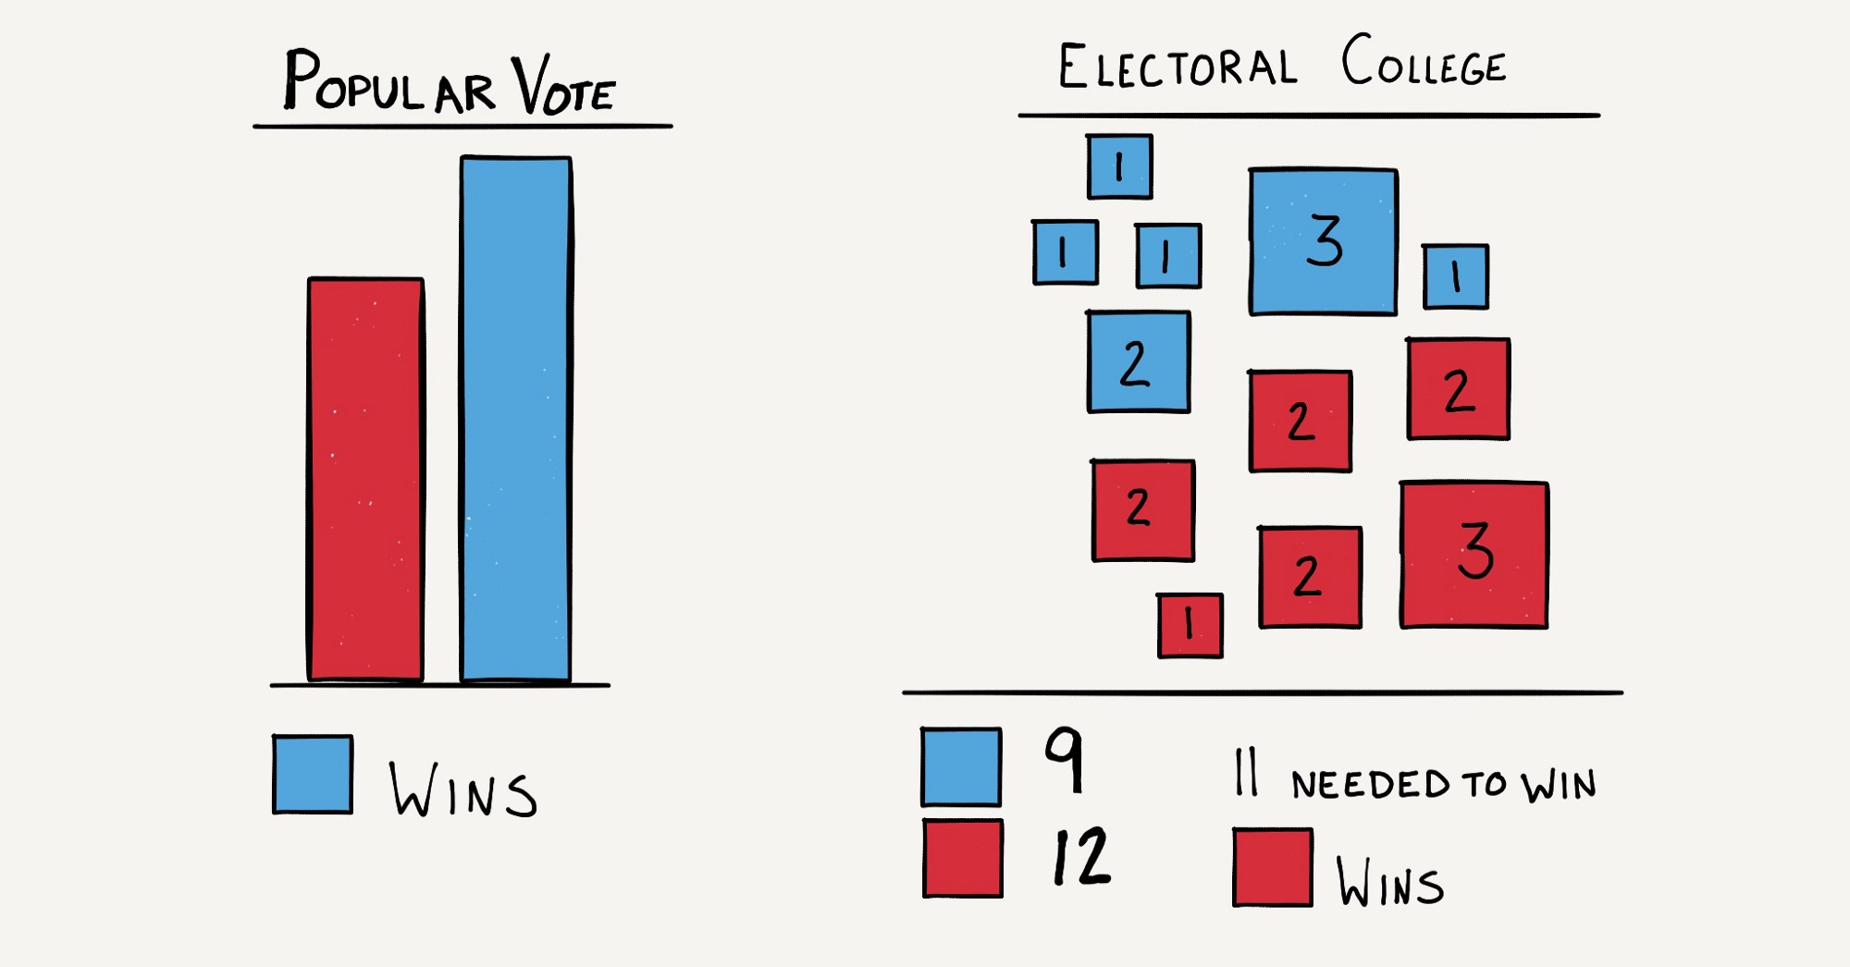
8
Notes:
Here is a graphical explanation of how the electoral college can give the Presidency to the candidate with fewer total votes.

Slide 34
So why not just abolish the Electoral College?
Abolishing the Electoral College requires an amendment to the U.S. Constitution.
LWVUS Position: Abolish the Electoral College.
Direct popular vote is essential for representative government.
Until the EC is abolished, the League believes the NPV is a way to achieve direct presidential election.
10
Notes:
Amending the constitution is extremely hard. There is no political will in the U.S. Congress to initiate this amendment.
The League believes abolition of the EC is the democratic way to elect the president.
Amending the constitution:
1) 2/3 of both houses of Congress and ratified by ¾ of the state legislatures or by state conventions in ¾ of the states
Or
2) 2/3 of state legislatures shall call a convention for proposing amendments and must be ratified by ¾ of the state legislatures or by state conventions in ¾ of the states.

Slide 35
NPV FAQ
Are Interstate Compacts legitimate?
Must there be congressional approval?
Will individual’s votes be counted equally in all states?
There are other compacts that are sanctioned by the Constitution
Supreme Court has ruled that many compacts need no congressional approval, but the Compact plans to seek the consent of Congress when many states adopt.
All voters in compacting and non-compacting states will be counted.
17

