Slide 1
Early Childhood Education: The National Perspective
Kathy R. Thornburg, Ph.D.
November 13, 2014
Notes:
Introductions:
Yourself
Everyone if fairly small group or at least have folks meet their neighbors if the group is too large for all to introduce themselves.
(This might be a good time to let them form groups of 3 or 4 because there will be several opportunities to work in small groups. Or you could wait and let groups vary a bit for the different assignments.)

Slide 2
From the months of . . .
A Sad Story
A shopping cart was my first crib.
My sister and me.
Our home was on the street.
Finally under a roof.
Two beds for six.
No is always on our minds. No running, no jumping, no fun.
--Shanika, age 5
Six People, Five Eat
There are six people in our family.
But only five sit down to dinner.
That’s because my mom doesn’t eat.
She wants to make sure we have enough food.
--Vanessa, age 6

Slide 3
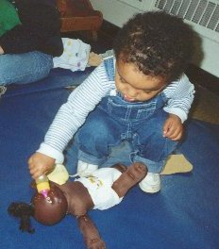
Why all the noise about young children?
Tonight I will talk about:
  Some relevant early childhood research
  Where are our early childhood programs
  Early Learning Challenge States—what are they working on that we could possibly learn from in Missouri
  What worries me the most
  What am I hopeful about

Slide 4
The State of America’s Children
One in 5 children—16.1 million—was poor in 2012.
For the first time the majority of children in America under age 2 were children of color in 2012 as were the majority of all children in 10 states (not MO).
Black children are the poorest (39.6%) followed by American Indian/Native Alaskan children ((36.8%) and Hispanic children (33.7%).
A child is abused or neglected every 47 seconds—infants and toddlers are the most likely victims.
Guns kill or injure a child or teen every half hour.
The State of America’s Children, 2014
Children's Defense Fund

Slide 5
The State of Early Childhood
Less than half of 3- and 4-year olds were enrolled in preschool in 2009-2011.
Early Head Start funding served only 4% of the 2.9 million eligible poor infants and toddlers; Head Start served 41% of the 2 million eligible 3- and 4- year olds.
Budget cuts have had a disproportionate impact on programs serving young children. From 2011 to 2012 total federal spending on children decreased 7% and spending on early childhood programs decreased by 12%.
In 2011, the average cost of center-based care for infants was greater than the annual tuition and fees for an in-state public college in 35 states and DC; for 4 year olds care was more than cost of college in 25 states and DC.
In 2011, the average cost for infants and toddlers was $9,520 per year. For preschoolers, it was $7,705.
The State of America’s Children, 2014
Children's Defense Fund

Slide 6
Socioeconomic Status
Socioeconomic status is one of the strongest predictors of performance differences in children at the beginning of 1st grade.

Slide 7
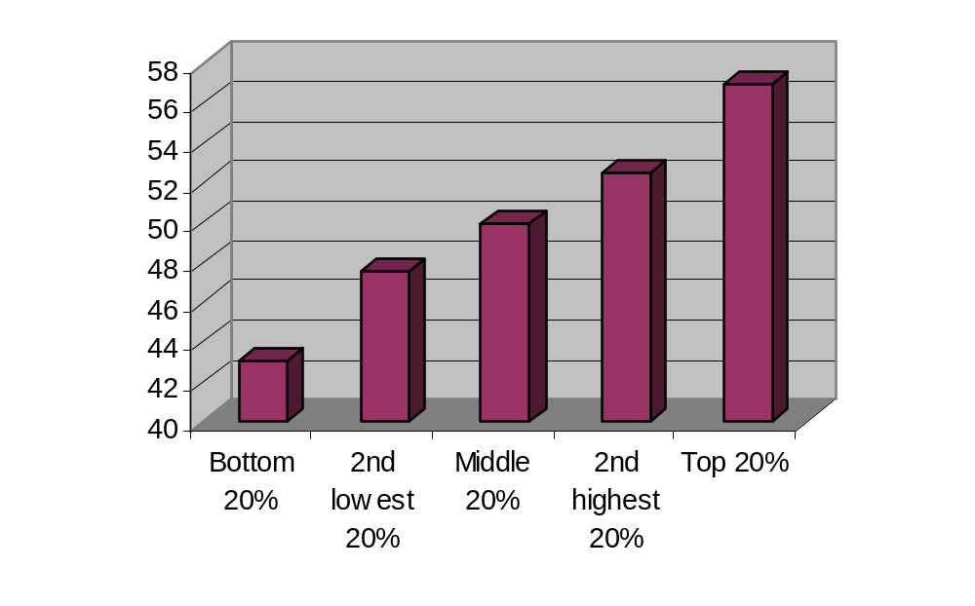
Cognitive Skills of Entering Kindergartners by Family Income
(NIEER Analysis of ECLS-K)
Notes:
Researchers divided the children into 5th’s (quintiles) based on family income and took math, language and literacy scores and developed a cognitive skills measure. As you see, scores for the children increased as family income increased.
Background in case anyone asks…(NIEER Analysis of ECLS-K): National Institute for Early Education Research took data from Early Childhood Longitudinal Study—K Cohort.
The Early Childhood Longitudinal Study, Kindergarten Class of 1998-99 (ECLS-K) focuses on children's early school experiences beginning with kindergarten and following children through middle school. The ECLS-K data provide descriptive information on children's status at entry to school, their transition into school, and their progression through 8th grade. The longitudinal nature of the ECLS-K data enables researchers to study how a wide range of family, school, community, and individual factors are associated with school performance.
his was a national study that randomized kids to study over many years. Thousands of children, families and teachers participated in the study throughout all of the years.

Slide 8
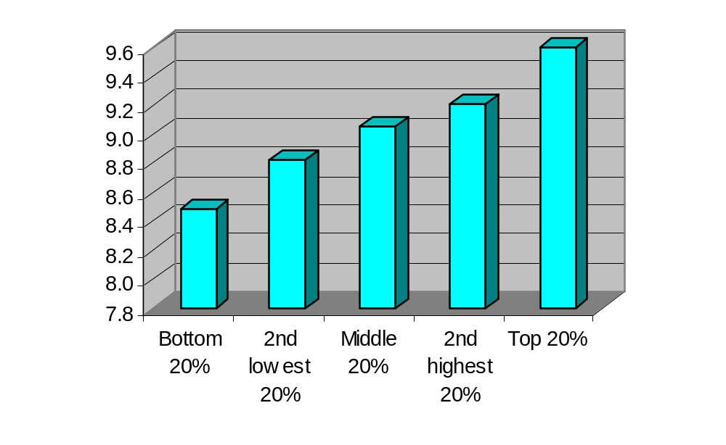
Social Skills of Entering Kindergartners by Family Income
(NIEER Analysis of ECLS-K)
Notes:
Same explanation for social skills—as children entered kindergarten, the more money in a family, the higher the children were rated on social skills.

Slide 9
Learning to Read
88% of children who have difficulty reading at the end of 1st grade have similar difficulties at the end of 4th grade (Juel, 1988)
75% of students who are poor readers in 3rd grade will remain poor readers in high school (Shaywitz et al., 1997)
Research indicates that early intervention can correct reading deficiencies in all but about 3-5% of the children (Torgesen, J.K., 2000)

Slide 10
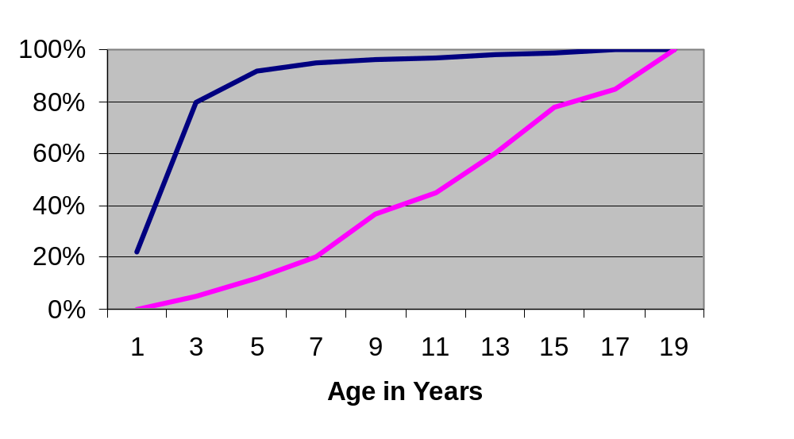
Investment in the Early Years
Notes:
Nationally—and in each state—the amount of public money spent on children’s services/education increases by age. As the brain is in the most rapid growth stage, the least amount of money is spent supporting the children.
This might be a good graph to share with policymakers!

Slide 11

Children Ready for School
Ready Families
Ready Communities
Ready Services
Ready Schools
Ready State (policies & funding)

Slide 12
Where are our babies, toddlers and preschoolers?
Home with parent/guardian/nanny/relative/babysitter/sibling
Family child care provider (regulated or unregulated)
Child care center (regulated or unregulated)
Head Start or Early Head Start
State-funded preschool
District-funded preschool
Title I-funded preschool
Early Childhood Special Education classroom
Home of FFN (Family, Friend or Neighbor)
OR, for many children, a combination of these settings.

Slide 13

Who’s in Charge?
This varies state-by-state, but in many states, several state departments have a piece of the “non-system”—Departments of Education, Social/Human Services, Mental Health, Health, Economic Development and more. Some programs come straight from the federal government (Head Start/Early Head
Start) and some federal dollars flow
through state departments
to local districts to operate
(ECSE; Title I, etc.).

Slide 14
Race to the Top: Early Learning Challenge Grants
In general, the 20 states that received millions of dollars to work on
Early Childhood Systems are working on the following issues:
Build and Enhance Successful State Systems
  Family support and engagement/parenting education issues
  Data systems
  Assessment systems (screening, formative assessment and KEA’s—Kindergarten Entry Assessments)
  Public/private partnerships
  Birth through 3rd grade systems, including transitions and alignment of curricula
Improve Program Quality, Access and Accountability
    Improve the quality of all early childhood programs (QRIS)
    Increase the number of children from families with high needs into high quality early childhood programs
    Strengthen inclusion of children with disabilities into programs
Enhance and Support Workforce
  Professional Development Registry
  Workforce issues—increase teacher qualifications, training and salaries

Slide 15
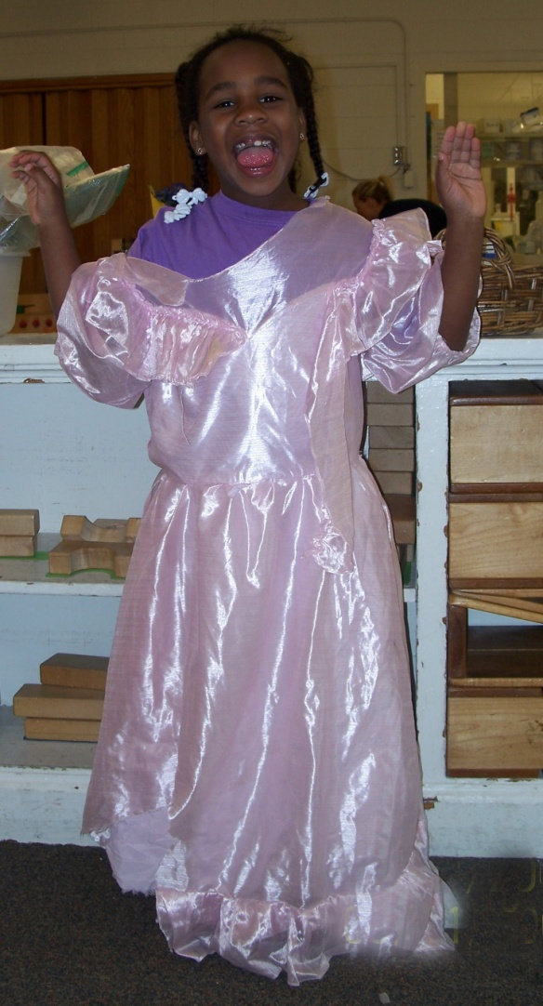
Action Steps: Possible Areas for Leadership in Developing an Early Childhood System
Families:
All families have access to:
supports during times of crisis
parenting education
services for children with disabilities
Health:
All children have access to:
medical home/primary care
dental care
mental health services
Notes:
Let’s look at lots of areas that need advocates. These are some possible areas you could choose to be an advocate. Be thinking of more!

Slide 16
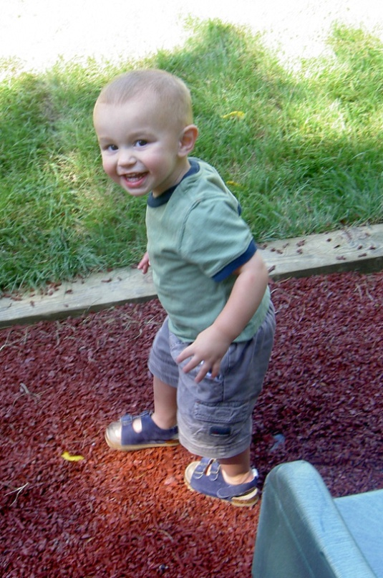
Early Childhood Programs/Schools:
All communities have . . .
high quality programs
Early Head Start/Head Start
Quality Rating and Improvement System
health and mental health resources
for EC teachers to support children
EC programs linked to schools
(transition plans; alignment of
curriculum)
Notes:
And, do you have any more to add?

Slide 17

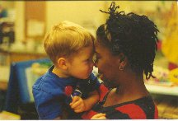

What worries me the most— for Missouri and our nation?
Babies
Quality of programs
Parent supports/education
Workforce—or lack of prepared workforce for expansion of preschool and requirements for infant/toddler teachers
School district/community-based program service delivery
Disjointed “systems”/funding streams

Slide 18
  We can be hopeful about . . .
  Federal government (U.S. Departments of Education and Health and Human Services) have 2 large grants out now:
  Preschool expansion or development grants
  EHS-Child Care partnership grants
  New rules for programs accepting child care assistance (subsidy) likely to begin in 2015
  "If we make high-quality preschool available to every child, not only will we give our kids a safe place to learn and grow while their parents go to work; we'll give them the start that they need to succeed in school, and earn higher wages, and form more stable families of their own. In fact, today, I'm setting a new goal: By the end of this decade, let's enroll 6 million children in high-quality preschool. That is an achievable goal that we know will make our workforce stronger."
  President Barack Obama
  Northwestern University, Oct 2, 2014

Slide 19
. . . "cornerstones of opportunity" for the United States:
The first of these cornerstones of [economic] opportunity I would describe more fully as "resources available to children in their most formative years." … One of the most consequential examples is early childhood education. Research shows that children from lower-income households who get good-quality pre-Kindergarten education are more likely to graduate from high school and attend college as well as hold a job and have higher earnings, and they are less likely to be incarcerated or receive public assistance. ... Access to quality early childhood education has improved since the 1990s, but it remains limited--41 percent of children were enrolled in state or federally supported programs in 2013.”
Janet Yellen,
Chair, Board of Governors
Federal Reserve System of the United States
October 17, 2014

Slide 20
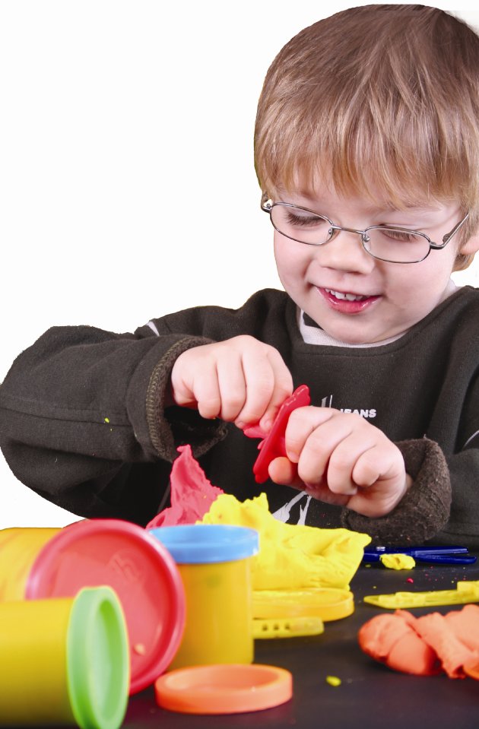
  We can work toward . . .
  Making our elected officials accountable to our youngest citizens and their families.

Slide 21
“Unfortunately, in an era of tight government budgets, it is impractical to consider active investment programs for all persons. The real question is how to use the available funds wisely. The best evidence supports the policy prescription: invest in the very young and improve basic learning and socialization skills.”
James Heckman, Ph.D.
Nobel Laureate in Economics

Slide 22
“Our lives begin to end the day we become silent about the things that matter.”
Martin Luther King, Jr.
Notes:
Now it is time to start planning for the workshop you will present to families in your program. NEXT SLIDE for Instructions

Slide 23

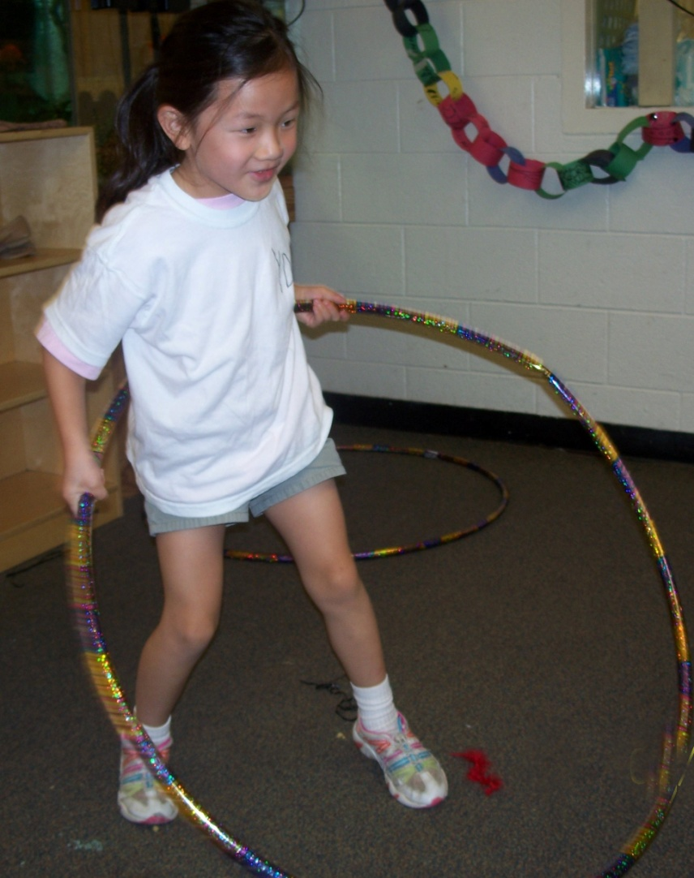
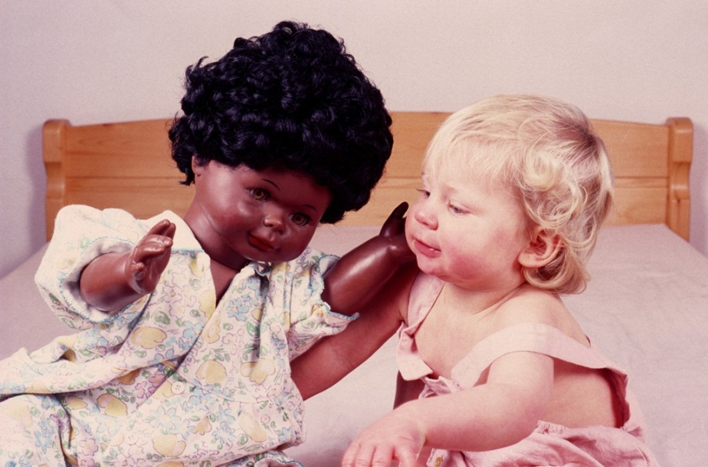
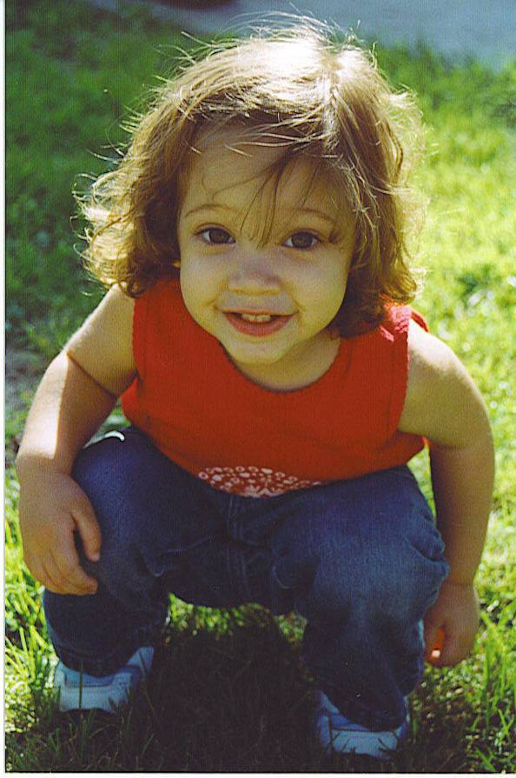

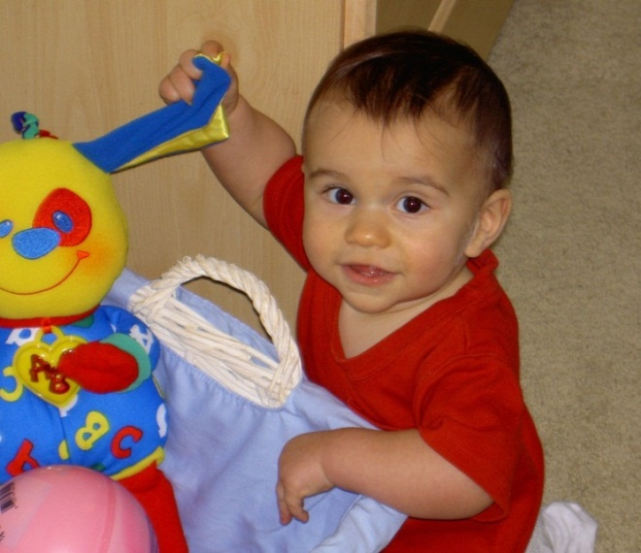
They thank you for caring—and speaking up!

