Slide 1
Disinformation and lack of civil discourse: Threats to Democracy?

Slide 2
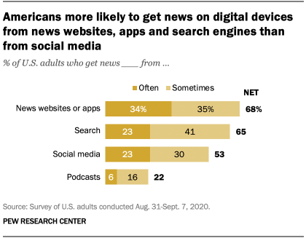

Slide 3
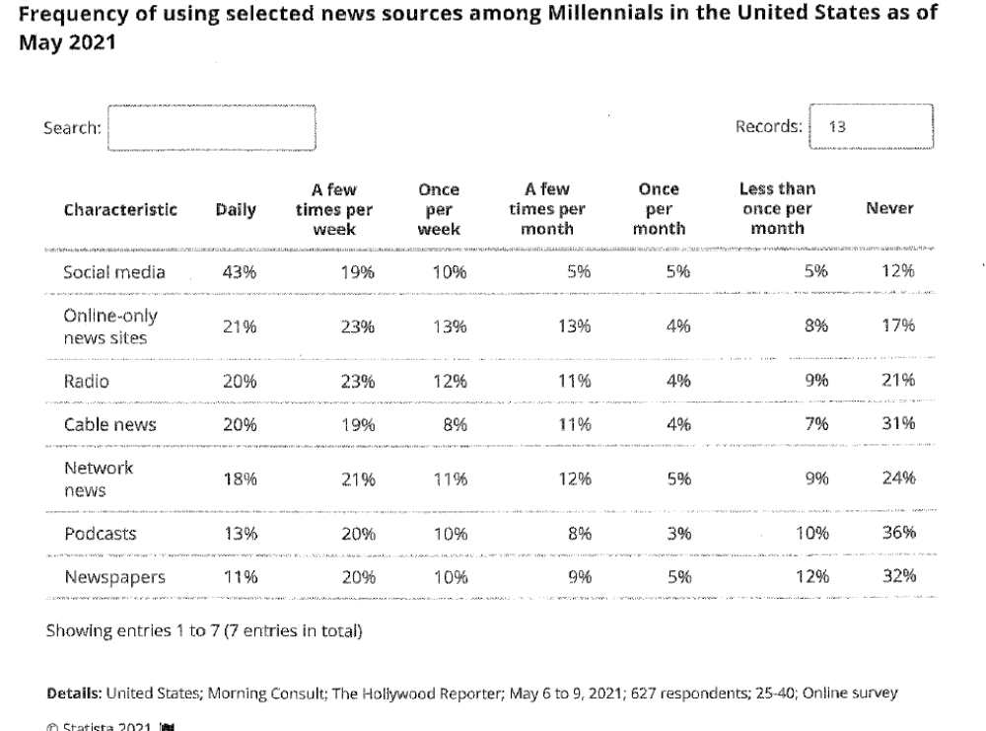

Slide 4
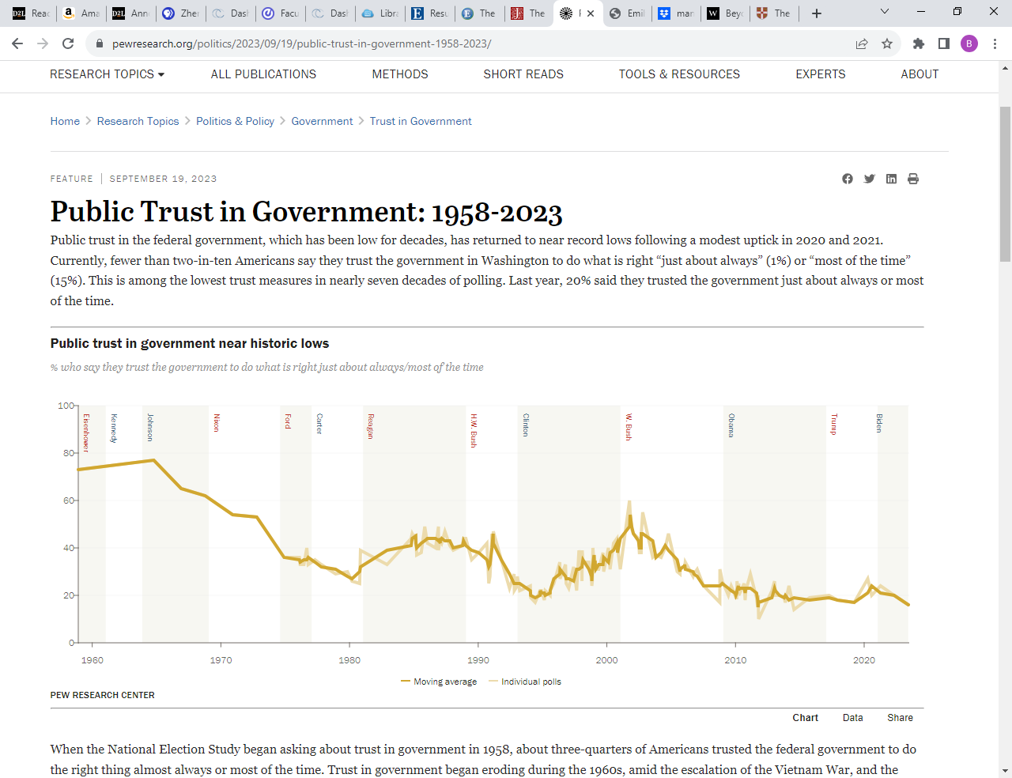

Slide 5
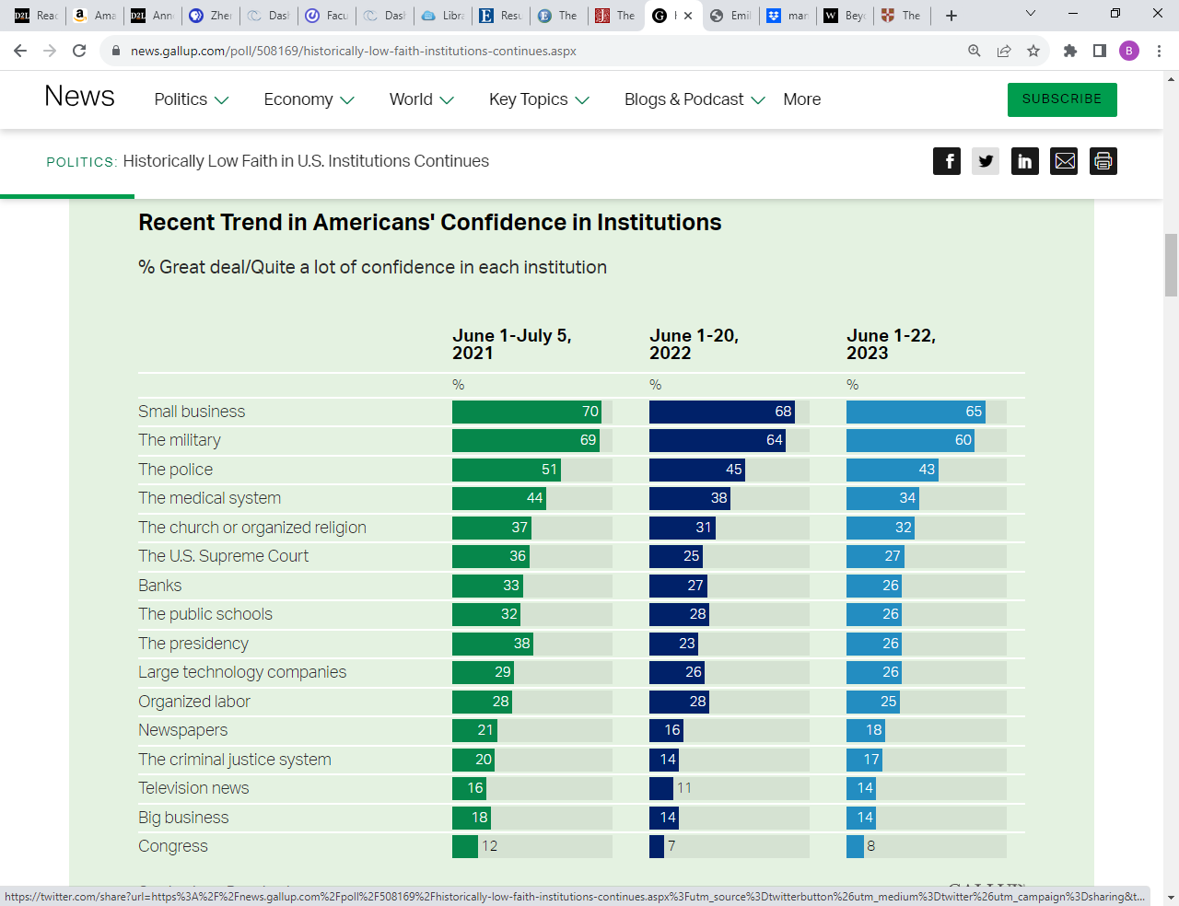

Slide 6
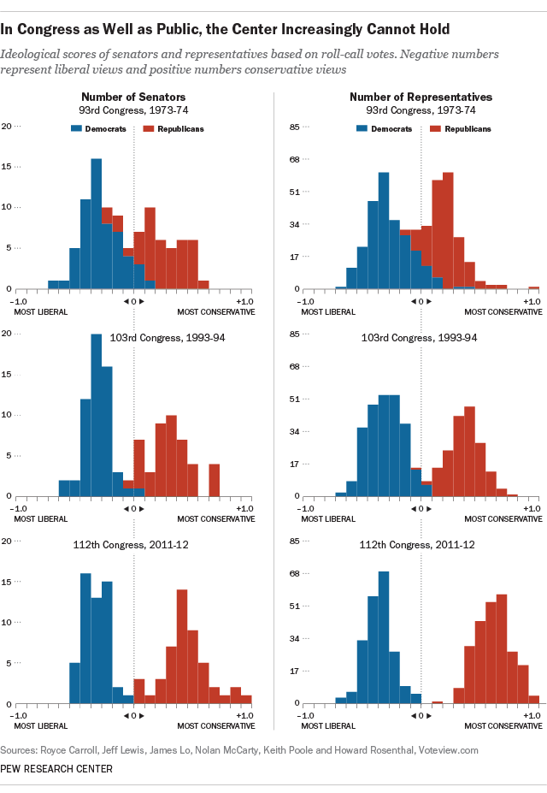

Slide 7
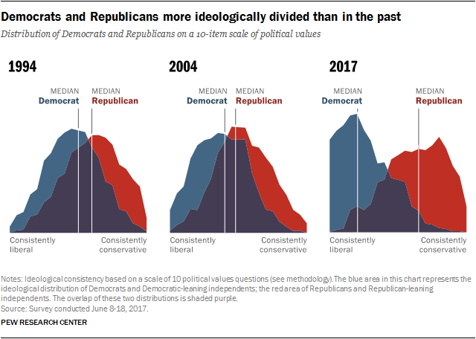

Slide 8
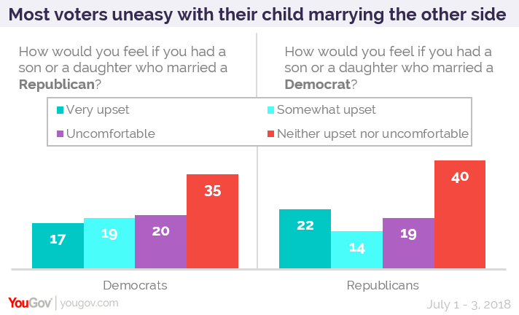
In 1960, 90% opposed interracial marriage, today 10%

Slide 9
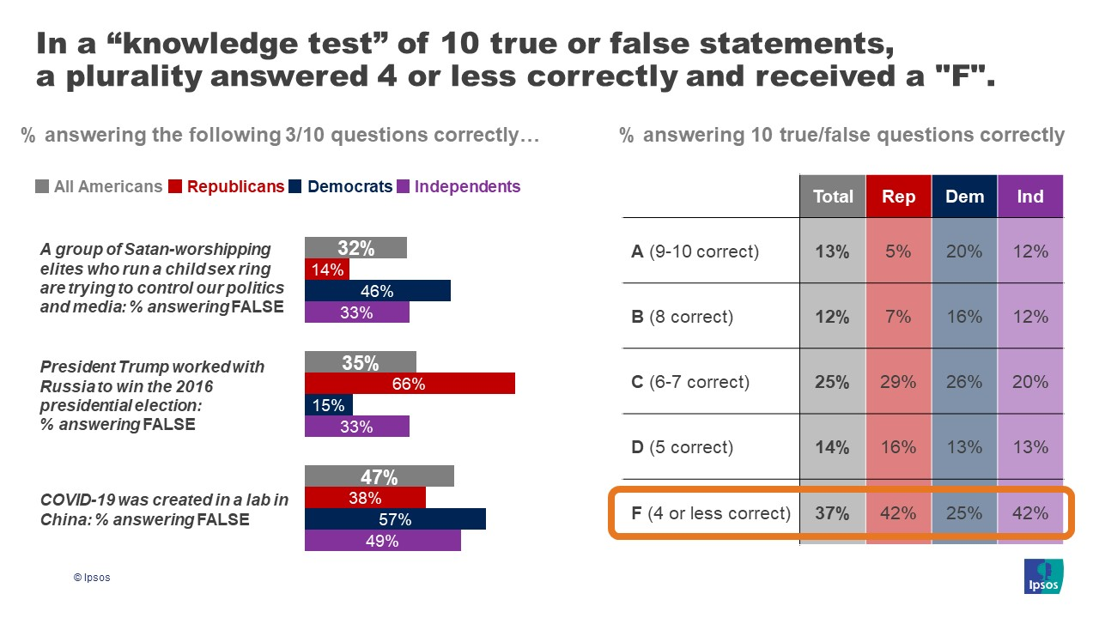

Slide 10
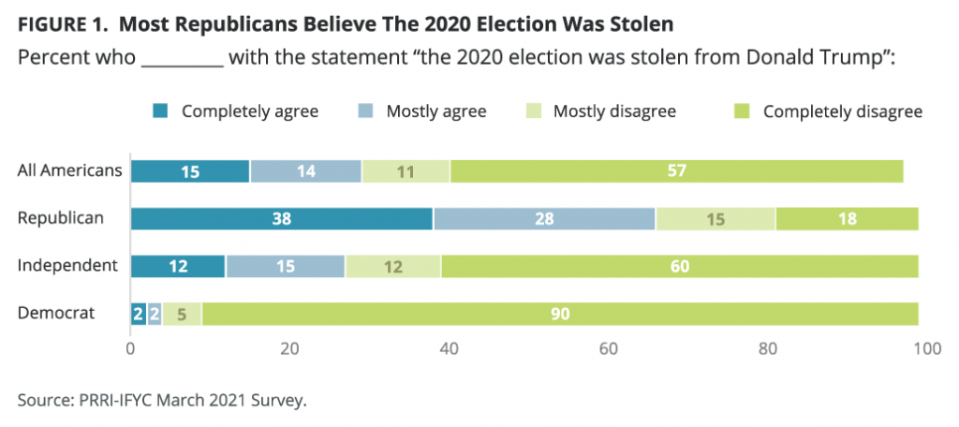

Slide 11
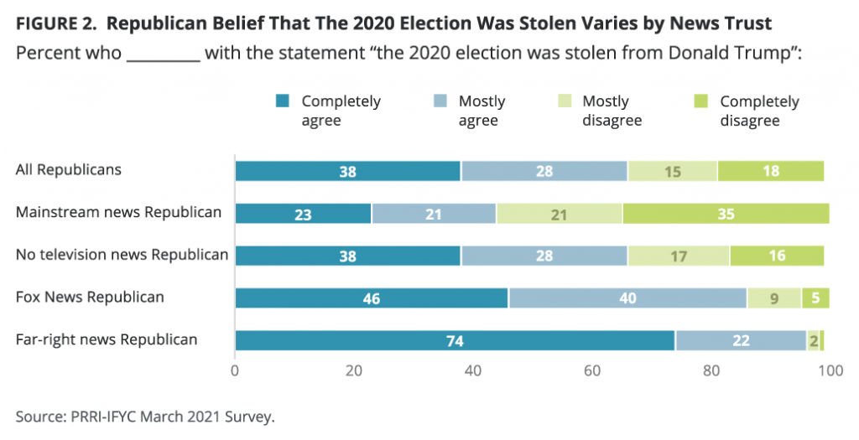

Slide 12
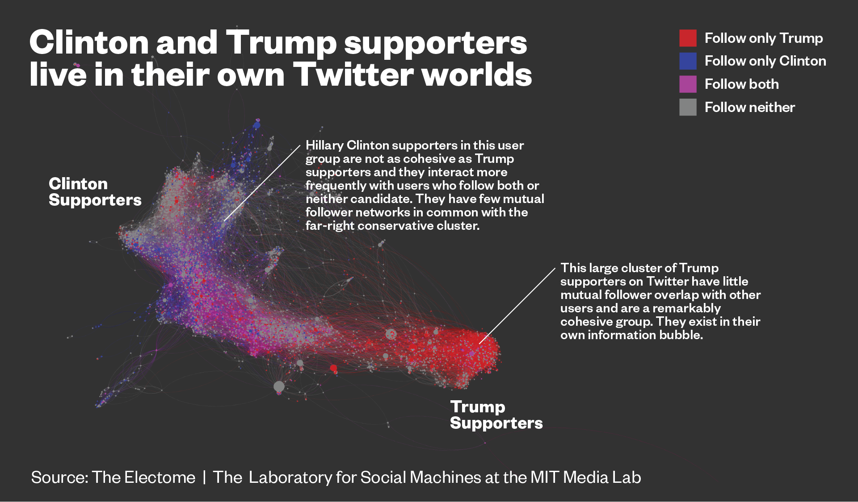

Slide 13
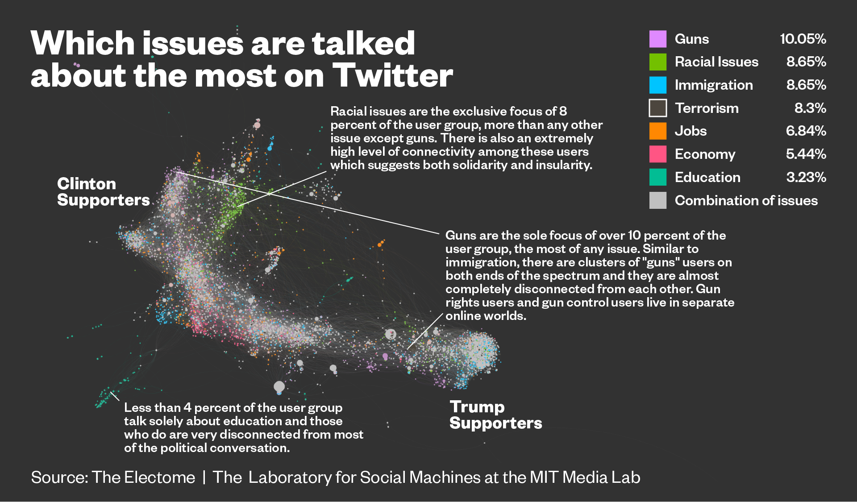

Slide 14
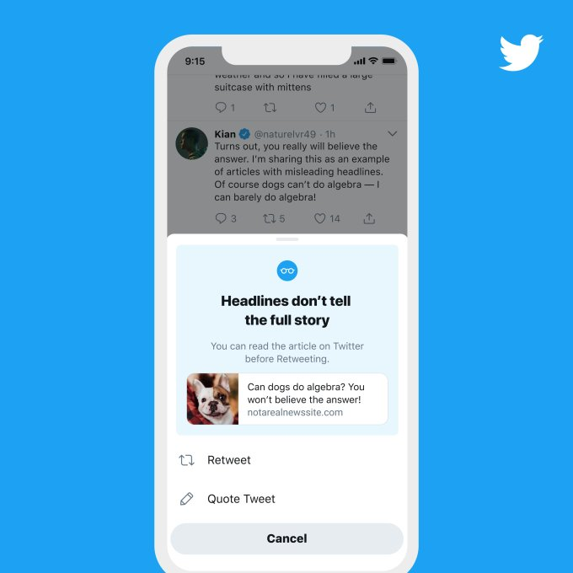
Combating Misinformation and Disinformation
Pre-bunking
Fact-Checking
Educational Games
Bad News (getbadnews.com)
Play GO VIRAL! | Stop Covid-19 misinformation spreading (goviralgame.com)
Social Media Prompts and PSAs
  30 second video cut willingness to share fake news 50%
  Twitter prompt to read articles before sharing

